Slide 1

Evidence on
SECURITY & CRIME SCIENCE
hotspot policing

Slide 2
Does patrol reduce crime outside hotspots?

Slide 3
“Patrol is considered the backbone of police work”
“The assumption underlying [patrol is] the presence … of officers patrolling the streets in marked police cars deters people from committing crime.”
Source: National Police Foundation. n.d. The Kansas City Preventive Patrol Experiment.

Slide 4
Kansas City Preventative Patrol Experiment (1972)
Patrol beats divided into three groups for one year
“proactive”
2–3 times normal level of patrol
“reactive”
emergency response only
“control”
normal level of patrol
Source: National Police Foundation. n.d. The Kansas City Preventive Patrol Experiment.

Slide 5
Kansas City Preventative Patrol Experiment
no change in recorded crime
no change in fear of crime
no change in perceptions of police
offenders didn’t notice the change …
… and neither did anyone else
Source: National Police Foundation. n.d. The Kansas City Preventive Patrol Experiment.

Slide 6

“It is not surprising that less than 1% of offenses end with the offender caught in the act by police on patrol.
“Doubling the number of police … is like doubling a drop in the bucket.”
Source: M Felson. Crime and Everyday Life. 3rd Ed. Thousand Oaks: Sage. p. 5

Slide 7
Does patrol reduce crime inside hotspots?

Slide 8
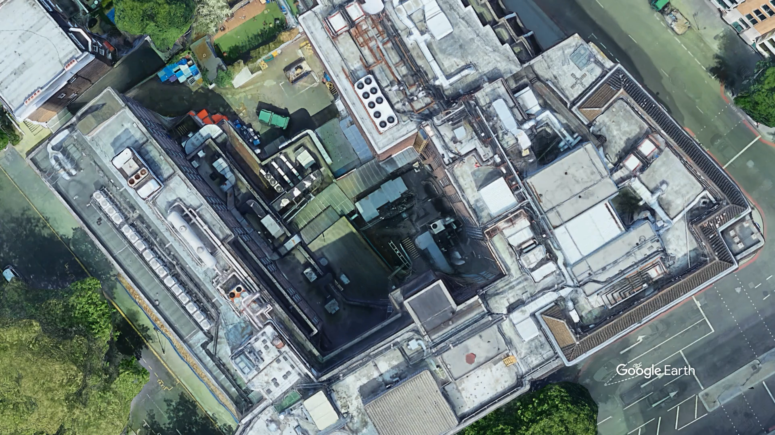

Slide 10
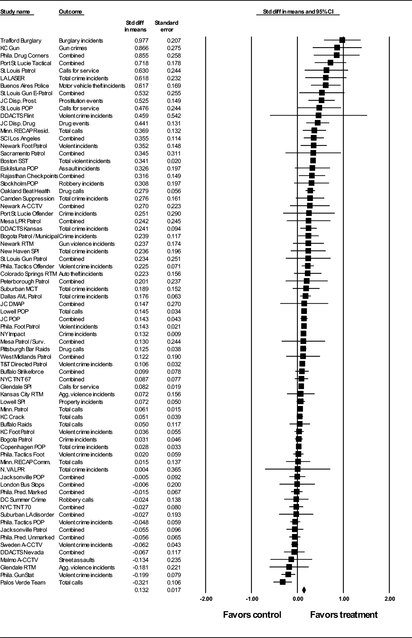
Hotspot patrols increased crime
Hotspot patrols reduced crime
Source: A Braga, B Turchan, A Papachristos & D Hureau. 2019. Hot spots policing and crime reduction: an update of an ongoing systematic review and meta-analysis. Journal of Experimental Criminology 15:289–311.
Notes:
Explain forest plot
Overall, significant decrease in crime
13 studies found significant decrease in crime
No studies found significant increase in crime

Slide 11
“The extant evaluation research provides fairly robust evidence that hot spots policing is an effective crime prevention strategy”
Source: A Braga, B Turchan, A Papachristos & D Hureau. 2019. Hot spots policing and crime reduction: an update of an ongoing systematic review and meta-analysis. Journal of Experimental Criminology 15:289–311.

Slide 12
Does the crime just move around the corner?

Slide 13
surrounding area
(no intervention)
intervention area
Diffusion of benefit
crime reduction moves beyond intervention area
Displacement
crime moves to surrounding area
Source: R Guerette & K Bowers. 2009. Assessing the extend of crime displacement and diffusion of benefits: a review of situational crime prevention evaluations. Criminology 47(4):1331–1368.

Slide 14
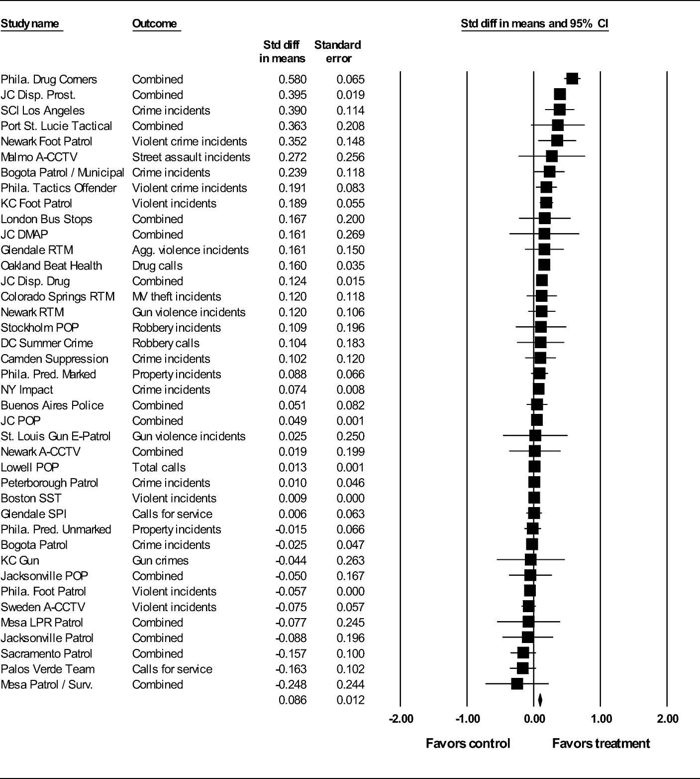
Crime was displaced
Benefit was diffused
Source: A Braga, B Turchan, A Papachristos & D Hureau. 2019. Hot spots policing and crime reduction: an update of an ongoing systematic review and meta-analysis. Journal of Experimental Criminology 15:289–311.
Notes:
Overall, significant diffusion of benefits
One study found significant displacement
Seven studies found significant diffusion of benefits

Slide 15
How much hotspot policing is enough?

Slide 16
“The greatest deterrent effect may be produced not by police staying in the same hot spot for extended periods, but by police roving from hot spot to hot spot, staying in each for only a limited time.”
Source: L Sherman & D Weisburd. 1995. General deterrent effects of police patrol in crime “hot spots”: A randomized, controlled trial. Justice Quarterly 12(4):625–648.

Slide 17
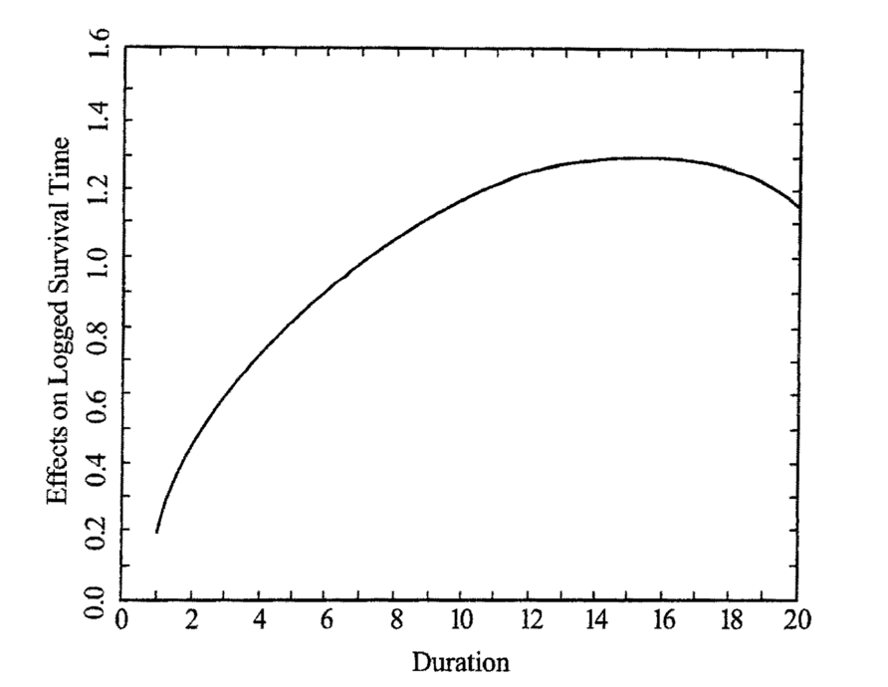
‘Koper curve’
too short, less effect
too long, wasted effort
Source: C Koper. 1995. Just enough police presence: Reducing crime and disorderly behavior by optimizing patrol time in crime hot spots. Justice Quarterly 12(4)649-672.

Slide 18
Fewer 10-minute patrols better than more 5-minute patrols
“the difference between 2.5 longer [10-minute] visits and 5 shorter [5-minute] visits causes about 20% less crime when longer visits are delivered”
Source: S Williams & T Coupe. 2017. Frequency Vs. Length of Hot Spots Patrols: a Randomised Controlled Trial. Cambridge Journal of Evidence-Based Policing 1(1):5–21.

Slide 19
Hotspot patrols can be done by civilian staff
“[patrols by PCSOs] with few arrest powers and no weapons [conducting] approximately two more ten-minute visits per day in treatment than in control [led to] 39% less crime … compared to control conditions”
Source: B Ariel, C Weinborn & L Sherman. 2016. “Soft” policing at hot spots—do police community support officers work? A randomized controlled trial. Journal of Experimental Criminology 12(3):277–317.

Slide 20
How will officers behave at hotspots?

Slide 21
Police officers can be agents of implementation failure
“we do that anyway”
“I’m not doing that”
“it’s not working – I’ll stop doing it”
“it makes me uncomfortable”
“I’m too busy”
“do you think I’m stupid?”
Source: S MacQueen & B Bradford. 2017. Where did it all go wrong? Implementation failure—and more—in a field experiment of procedural justice policing. Journal of Experimental Criminology 13(3):321–345.

Slide 22
Hotspot patrol can change officers’ understanding of communities
“officers responded that they gained an understanding of ‘good’ people's problems, giving them a different vantage point from officers who had never walked the beat”
Source: J Wood, E Sorg, E Groff, J Ratcliffe & C Taylor. 2014. Cops as treatment providers: realities and ironies of police work in a foot patrol experiment. Policing and Society 24(3):362–379.

Slide 23
Hotspot patrol can change officers’ understanding of communities
“‘[police] were surprised at how the residents rarely had crime concerns, but were more interested in resolving quality of life issues (the trash, nuisance neighbours, and unruly youths) ’”
Source: J Wood, E Sorg, E Groff, J Ratcliffe & C Taylor. 2014. Cops as treatment providers: realities and ironies of police work in a foot patrol experiment. Policing and Society 24(3):362–379.

Slide 24
Local knowledge can change officers’ choice of tactics
“[the] decision to give [a man drinking in public] a free pass … was driven in large part by the fact that he was a known resident … had he been an outsider, [the officers] stated, he would have been brought in”
Source: J Wood, E Sorg, E Groff, J Ratcliffe & C Taylor. 2014. Cops as treatment providers: realities and ironies of police work in a foot patrol experiment. Policing and Society 24(3):362–379.

Slide 25
Officers may stray from hotspots
“all [officers] reported patrolling at locations outside [the] foot beats that they were initially assigned to patrol”
Source: E Sorg, J Wood, E Groff & J Ratcliffe. 2014. Boundary Adherence during Place-based Policing Evaluations: A Research Note. Journal of Research in Crime and Delinquency 51(3):377–393.

Slide 26
Officers think hotspot foot patrol increases intelligence gathering
“‘[People will] voice their concerns that they normally don’t want to call in and have an officer respond to … ’
‘[Y]ou get to really know who belongs, who doesn’t belong … the people that live and, or, work in that area, and the people that … are potentially causing crime in that area … ’”
Source: C Haberman & W Stiver. 2019. Using officers’ perspectives to guide the implementation of hot spots foot patrols. Policing and Society (advanced online).

Slide 27
Police officers may not like rigid hotspot patrols
Officers assigned to hotspots were …
… less likely to say hotspot patrols are useful
… less likely to believe hotspot policing effective
… more likely to say hotspot patrols restrict discretion
… even though the hotspot patrols reduced crime
Source: N Wain, B Ariel & J Tankebe. 2017. The collateral consequences of GPS-LED supervision in hot spots policing. Police Practice and Research 18(4):376–390.

Slide 28
Officers may become apathetic over time
“[officers] said that they were sick of seeing and dealing with the same [problems] … At first they thought it was valuable [but now] it's annoying to be dealing with the same problems on a daily basis”
Source: J Wood, E Sorg, E Groff, J Ratcliffe & C Taylor. 2014. Cops as treatment providers: realities and ironies of police work in a foot patrol experiment. Policing and Society 24(3):362–379.

Slide 29
Effects of hotspot policing on police legitimacy

Slide 30
Legitimacy helps effective policing
“When the police … communicate with people fairly, respectfully, neutrally, trustworthily [the public] are more likely to voluntarily comply with laws and cooperate with police directives”
Source: S Bennett, M Newman & M Sydes. 2017. Mobile police community office: a vehicle for reducing crime, crime harm and enhancing police legitimacy? Journal of Experimental Criminology 13(3):417–428.

Slide 31
But does hotspot policing damage legitimacy? Possibly
“[the] study shows short-term negative effects on procedural justice and potentially on police legitimacy among [dedicated patrol] hot spot residents …
“[but] the effects are small, and … they are not sustained in the long term once treatment concludes.”
Source: T Kochel & D Weisburd. 2017. Assessing community consequences of implementing hot spots policing in residential areas: findings from a randomized field trial. Journal of Experimental Criminology 13(2):143–170.
Notes:
Study in St Louis, MO
Hotspots randomly allocated to additional patrol or not
Survey of residents before, during and six-months after

Slide 32
But does hotspot policing damage legitimacy? Possibly not
“we compared residents’ perceptions of procedural justice and police effectiveness as well as their trust in the police and fear of crime … we found no statistically significant difference between residents who lived in the control hot spots and those in the experimental condition”
Source: S Bennett, M Newman & M Sydes. 2017. Mobile police community office: a vehicle for reducing crime, crime harm and enhancing police legitimacy? Journal of Experimental Criminology 13(3):417–428.
Notes:
Study in Queensland
Hotspots randomly allocated to get a mobile police station visit or not
No difference in survey results between groups, but no change in crime either

Slide 33
What happens when hotspot policing ends?

Slide 34
If hotspot policing works by deterrence, what happens when the deterrent goes away?
“Three months after the experiment, the statistically significant differences in violent crime between the experimental and control areas could no longer be detected.”
Source: E Sorg, C Haberman, J Ratcliffe & E Groff. 2013. Foot patrol in violent crime hot spots: the longitudinal impact of deterrence and posttreatment effects of displacement. Criminology 51(1):65–101.

Slide 35
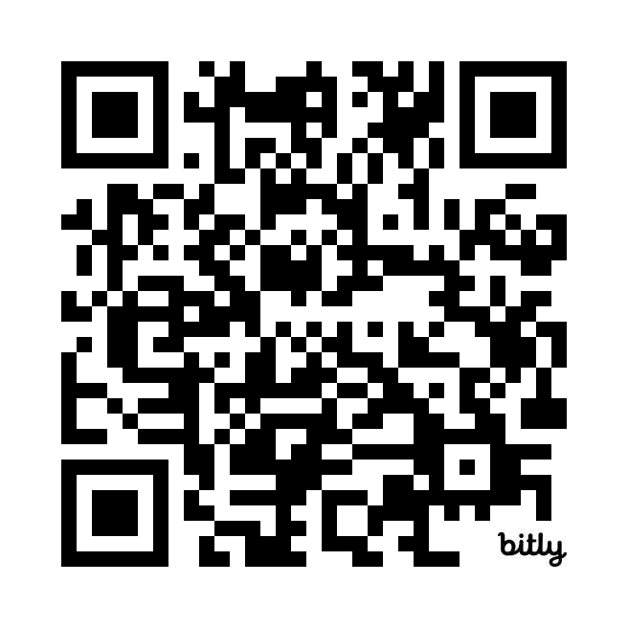
Get in touch: matthew.ashby@ucl.ac.uk

